Slide 1
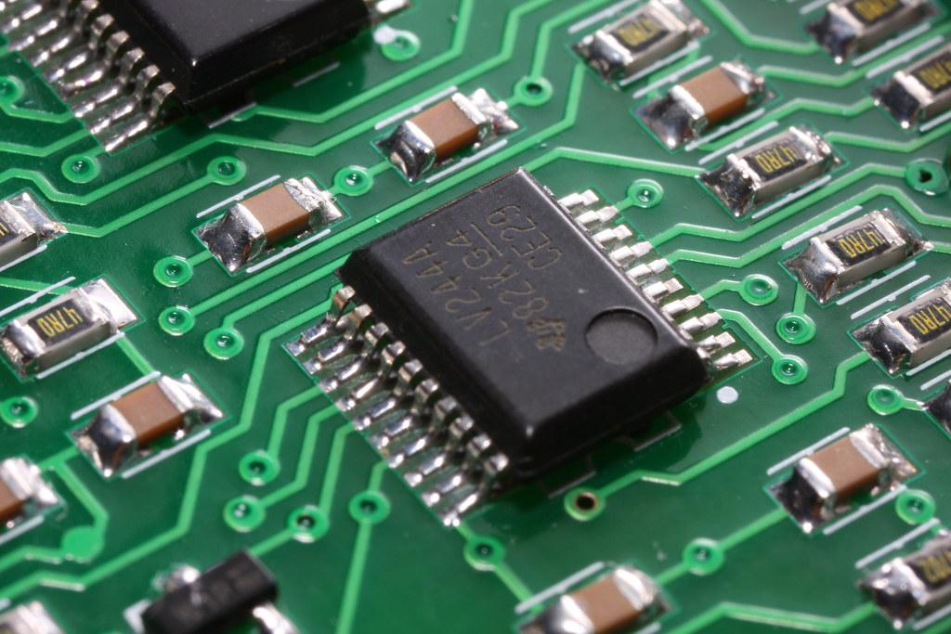
FPGA DEVICES SURVEY AND ANALYSIS
Ravindu Athukorala

Slide 2
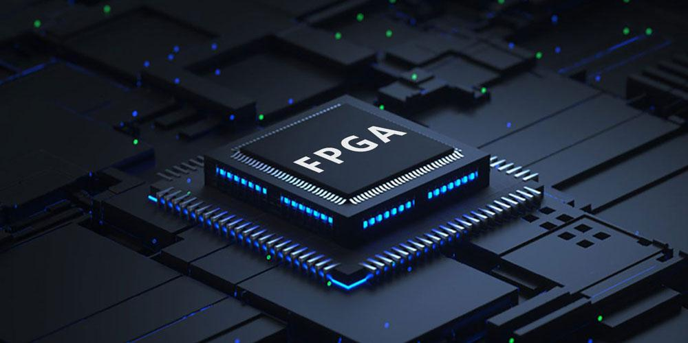
OVERVIEW OF ALL MANUFACTURERS
AMD Xilinx
Intel Altera
Lattice Semiconductor
Microsemi

Slide 3
AMD XILINX
Global presence and headquarters
Xilinx, founded in Silicon Valley in 1984, has a global presence with primary headquarters in San Jose, USA.
The company maintains offices in various locations worldwide, including the USA, Ireland, Singapore, India, China, Australia, Japan, and Armenia.
Name Origin and Programmable Logic
According to former CTO Bill Carter, the name Xilinx symbolizes the chemical symbol of silicon and the links that connect programmable logic blocks.
The focus on programmable logic has been a key aspect of Xilinx's identity and technology development.

Slide 4
Advancements in Defense-Grade Products
In 2018, Xilinx upgraded its XQ UltraScale+ defense-grade products using TSMC’s advanced 16nm FinFET manufacturing process.
These products, including XQ Zynq UltraScale+ MPSoCs, RFSoCs, Kintex, and Virtex FPGAs, were the industry’s first defense-grade heterogeneous multi-processor SoC devices.
AMD-Xilinx Merger and Market Leadership
The AMD-Xilinx merger, finalized in February 2022, valued Xilinx at 35 billion USD.
Post-acquisition, all Xilinx products are co-branded as AMD Xilinx, marking a consolidation under AMD's branding since June 2023.
AMD Xilinx has emerged as the leader in the FPGA market, controlling over 50 percent of the world’s FPGA market share.
Future strategies involve targeting the high-performance computing market with Xilinx FPGAs.

Slide 5
INTEL ALTERA
Long-Standing Collaboration and Acquisition
Intel's involvement in programmable logic dates back to its collaboration with Altera before the acquisition in 2015.
The two companies had a history of collaboration, with Intel licensing Altera's technology for use in its programmable products until Altera acquired Intel's PLD division in 1994.
Altera's Innovative Approach and FDSOI Technology
From December 2012, Altera adopted the fully depleted silicon-on-insulator (FDSOI) chip manufacturing technique to create system-on-a-chip FPGA devices.
These devices integrated FPGAs and ARM-based hard processor systems into a single unit, showcasing a forward-looking approach.

Slide 6
Evolution of Intel FPGA and SoC Offerings
Intel's FPGAs and SoCs have evolved significantly from their early EP300 days
Today, developers can choose from a range of options suitable for diverse applications, including low-power consumer devices, industrial and automotive solutions, and high-performance data centers
Market Leadership and Product Range
Intel Altera is currently the second leader in the global FPGA market, holding approximately thirty-three percent of the worldwide FPGA market share.
The product range covers the low-end, mid-end, and high-end markets with complex programmable logic devices and high-end field programmable gate arrays.
Highlight specific FPGA series, including Arria, Stratix, Max, Cyclone, and Agilex, which cater to different market segments.

Slide 7
LATTICE SEMICONDUCTOR
Founding and Resilience
Founded in 1983 by Norm Winningstad in Hillsboro, United States, Lattice Semiconductor faced early struggles and declared bankruptcy in July 1987.
Remarkably, the company emerged from bankruptcy after sixty-two days, restructured, and relocated its headquarters to an unincorporated area.
Focus on Low-Power FPGAs
Lattice Semiconductor is recognized as the world's low-power FPGA leader.
The company specializes in small, low-power FPGAs and offers programmable mixed-signal and interconnect products, along with associated software and intellectual property (IP).

Slide 8
Product Lines and Applications
Lattice Semiconductor's key product lines include general-purpose FPGAs in the ECP and Certus-NX series, video bridging and processing-focused CrossLink FPGAs, low-power ICE FPGAs, and control and security-focused MachXO FPGAs.
These products find applications in various scenarios, including cloud computing and edge computing.
Global Presence and Employee Count
With over 700 employees worldwide, Lattice Semiconductor is headquartered in Hillsboro, United States, situated in the Silicon Forest high-tech area.
Despite a reduction in the workforce, the company managed to post record revenue after restructuring.
Independence After AMD's Acquisition
Following AMD's acquisition of Xilinx in 2022, Lattice Semiconductor became the only fully independent large-scale FPGA manufacturer in the world.
As of today, the company controls around 10 percent of the world's FPGA market share.

Slide 9
MICROSEMI
Founding and Company Overview
Founded in 1959 in the United States by Arthur Feldon and Steve Manning, Microsemi was an American semiconductor company.
It played a significant role in providing a diverse range of semiconductors and system solutions for the aerospace, defense, communication, and industrial markets.
Focus on High-Performance Technologies
Microsemi primarily focused on producing high-performance and radiation-hardened analog mixed-signal integrated circuits (ICs), FPGAs, SoCs (system-on-chips), ASICs (application-specific integrated circuits), and power management products.

Slide 10
Markets and Product Range
Microsemi serve three main markets: Aerospace and Defense, Communications, and Industrial.
Their product range included high-performance and radiation-hardened analog mixed-signal ICs, FPGAs, SoCs, ASICs, and power management products.
Aerospace and Defense Solutions:
In the Aerospace and Defense market, Microsemi's products played a crucial role in avionics systems, providing precision timing, data conversion, and signal processing.
The company's radar solutions, including RF front-ends, ADCs, and DSPs, were utilized in applications like air traffic control, weather radar, and military radar.
Microsemi's security solutions, featuring FPGAs, SoCs, and ASICs, met the stringent security requirements of aerospace and defense applications, being applied in secure communications, encryption, and authentication.
Communication Solutions
Microsemi's communication solutions found applications in various areas, including Wireless Communication (WiFi, LTE, 5G), Industrial Communication (industrial networking protocols, remote I/Os), and Data Center.

Slide 11
FPGA ARCHITECTURE
Configurable Logic Blocks (CLBs)
Core elements of FPGA architecture.
Consist of look-up tables, multiplexers, flip-flops, and other elements.
Look-up tables provide the ability to implement combinational logic, allowing users to define specific functions.
Programmable Interconnect (PIN)
Utilizes a grid of programmable interconnects for routing signals between CLBs.
Interconnects are dynamically configurable, enhancing flexibility in signal routing.

Slide 12
3. Input/Output Blocks
Facilitate interfacing with the external world by connecting FPGA to input and output devices.
Configurable to adapt to specific interface requirements.
4. Clock Management
Includes resources for clock management, such as phase-locked loops (PLLs) and delay-locked loops (DLLs).
Enables control over clock signals, crucial for synchronization and timing.
5. Embedded Memory
Many FPGAs incorporate embedded memory blocks, including Block RAM and Distributed RAM.
Used for data storage, memory-intensive tasks, and buffering, contributing to overall FPGA performance
enhancement.

Slide 13
FPGA DESIGN METHODOLOGY AND TOOLS
Design Specifications
Begin with defining the desired functionality and performance requirements of the digital circuit.
High-Level Hardware Description Languages (HDLs)
Use high-level hardware description languages such as Verilog or VHDL to create a register transfer level (RTL) representation of the design.
Synthesis
Utilize synthesis tools to map the HDL representation into a netlist, a description of the logical connections between the elements in the design.
Place and Route
Employ place and route tools to determine the optimal physical placement of different parts of the design on the FPGA chip and establish the connections between them.

Slide 14
5. Timing Verification
Check the timing of the design to ensure that it meets the required specifications for speed and performance.
6. Bitstream Generation
Generate a bitstream file, which contains instructions for configuring the FPGA. This file will be uploaded to the
FPGA to define its functionality.
TOOLS
Synthesis tools - Xilinx Vivado: For Xilinx FPGAs./Intel Quartus Prime/Synopsys Design Compiler, Cadence Genus
Simulation tools - ModelSim/VCS (Verilog Compiler Simulator): A simulator from Synopsys./Questasim
Place and Route Tools - Vivado Implementation/Synopsys IC Compiler II
Timing Analysis Tools - TimeQuest Timing Analyzer (Quartus Prime)/Vivado Timing Analyzer
Programming Tools - Xilinx Impact, Vivado Hardware Manager/Quartus Prime Programmer
Debugging Tools - Integrated Logic Analyzer (ILA)/SignalTap (Quartus Prime)

Slide 15
APPLICATIONS OF FPGA
Artificial Intelligence (AI)
High-end AI devices, particularly those relying on deep neural networks, benefit from powerful and energy-efficient tools provided by FPGAs.
Energy-efficient accelerators like P-Neuro showcase the efficiency of FPGAs, outperforming regular chips (GPUs) in terms of both speed and energy consumption.
Space Technology
In Satellite Systems, FPGAs enhance communication system performance by enabling onboard processing activities such as data compression, encryption, and signal processing.
Reconfigurable nature allows FPGAs to be updated and modified in-flight, adapting to changing mission needs.

Slide 16
Defence Systems
FPGAs are utilized in defense systems for their fast data processing capabilities, providing safety, high performance, and integration.
Anti-tamper technology reduces the risk, and FPGAs play a crucial role in electronic warfare systems, where ECCM (Electronic Counter-Countermeasures) is essential.
Renewable Energy Systems
In solar charging systems, FPGAs play a vital role in adjusting and rotating solar panels to face sunlight perpendicularly, ensuring optimal energy absorption.
Used in systems utilizing electromagnetic waves to break down limescale deposits in pipes, preventing oxidation.
Sensor-based FPGA systems detect toxic gases, showcasing versatility in various applications in renewable energy systems.

Slide 17
CHALLENGERS AND OPPORTUNITIES
Challengers
Complexity of design
Resource constraints
High development cost
Opportunities
Hardware Acceleration
Reconfigurability
Parallel processing

Slide 18
Conclusion

